Slide 1


Final Year interim presentation
Sasha Kuechenmeister
C18404082
Tu857
Supervisor: Anh Duong Trinh

Slide 2
Project Idea
Create a recipe finder app using tinder-like swipeable mechanism.
1/3 of millennials find searching for recipes tedious
Find new recipes in a fun, addicting and less tedious way

Slide 3
research
Evaluating similar applications
Researching most suitable technologies
Testing methods
System design

Slide 4
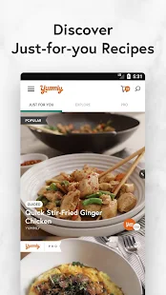
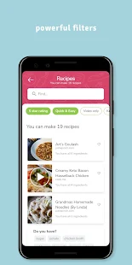
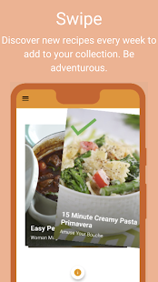
Existing Applications
Yummly SuperCook ShuffleChef

Slide 5
Chosen technologies
Smartphone App vs Web App
Smartphone larger market share
More people shifting to smartphones
Portable

Slide 6
Chosen technologies (2)
Android OS
Largest market share
Cheaper publish fees
Java
Previous experience
Default language of android

Slide 7
Chosen Technologies (3)
Firebase
Real-time database management system.
Backed by Google.
Easy to implement with Android Studio.
Cloud-hosted.
No internet connection required.

Slide 8
Chosen technologies (4)
Spoonacular API
Access to 360,000 recipes.
Open-source database.
Uses natural language.
Automatically analyses recipes for a common allergens.
Display if recipe is vegan, vegetarian, etc.

Slide 9
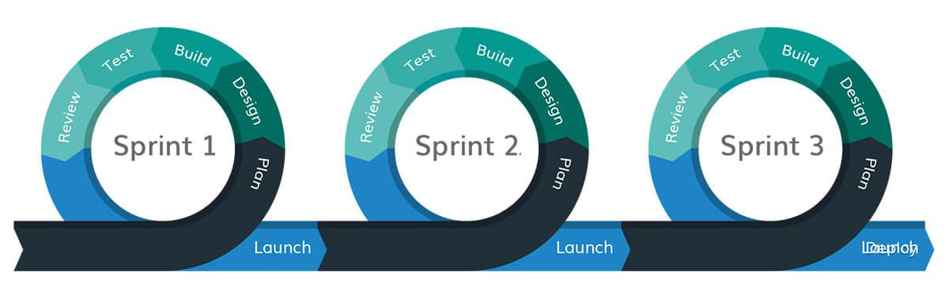
Software Methodology
Agile Methodology
Feature Driven Development (FDD)

Slide 10
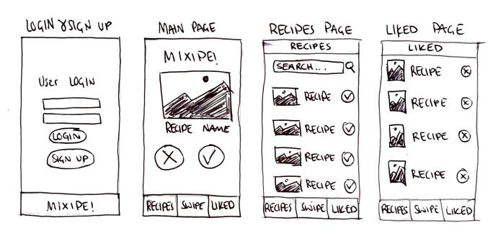
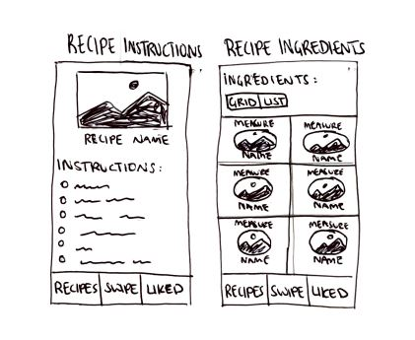
Front-End Design

Slide 11
Testing
Unit Testing
Blackbox Testing
Manual Testing

Slide 12
Future work
Follow Gantt Chart
Implement main features
Design

Slide 13
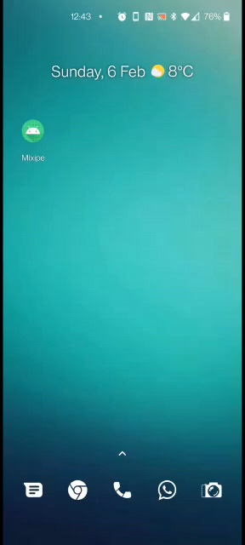
Mixipe Demo

Slide 14


